Slide 1
Logistics Tracking Details using Excel
STUDENT NAME :ABINAYA.G
REGISTER NO :
DEPARTMENT :B.COM Accounting and Finance
COLLEGE :Anna adarsh College for Women
NM ID :DB0E5D2A20531CB801840A30CEF9B924

Slide 2
PROJECT TITLE
Logistics Tracking Details using Excel

Slide 3

AGENDA
Project Overview
Problem Statement
End Users
Our Solution and Proposition
Modelling Approach
Strategies for Success
Conclusion

Slide 4
PROJECT OVERVIEW
Order Number
Period
Order Value
Order Confirmation
Status
Order Location
Order Type

Slide 5
PROBLEM STATEMENT
Items are damaged during handling or shipping
Shipping costs are unreasonably high
Lack of knowledge about international shipping
Shipping route disruptions
Lost items
The stress of split shipments
Harsh environmental conditions along the shipping route
Shipping hazardous materials
The cost of repairing or replacing damaged goods

Slide 6
WHO ARE THE END USERS?
HR Managers
Department Heads/Managers
Finance Team
Executive Leadership
Recruitment Team
Employee Relations Specialists
Compliance Officers
Data Analysts

Slide 7

OUR SOLUTION AND ITS VALUE PROPOSITION
Solution:
Conditional Formatting: To ensure early distribution of higher value orders, prioritize and ship those with the highest monetary value, and it is Highlighted in Value column for urgent or belong to high-priority customers for immediate action.
Value Proposal:
- Improved Insight: Simplifies data interpretation and trend identification.
- Enhanced Efficiency:Speeds up data analysis and reporting.
- Strategic Decision-Making: Supports better management and strategic planning.

Slide 8
MODELLING - Data Structuring: Organize data into relevant columns. - Transformation: Standardize and categorize data. - Conditional Formatting: Highlight key metrics like salary and tenure. - Analysis: Use descriptive statistics and trend analysis. - Visualization: Create charts for clear insights. - Reporting: Summarize findings with visual aids. SUMMARY Data analysis involves examining, transforming, and modeling data to Extract insights , identify patterns, and support decisions-making.

Slide 9
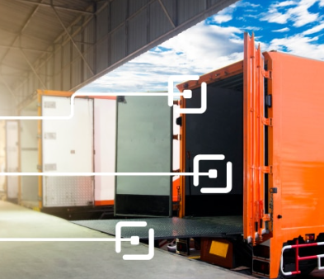
Strategies for Success
Think long-term
Plan for the short-term
Build supplier relationships to
empower logistics optimization
Use state-of-the-art logistics
management software

Slide 10
Conclusion
Logistics Tracking Details using Excel provided valuable insights into logistics trends enabling more informed decision-making.
The use of Excel allowed efficient data organization, visualization and reporting, ultimately helping to enhance to Logistics manager to improve and optimize overview the logistics details with the help of tracking details excel.

